Slide 1
Computer Architecture
Group two

Slide 2
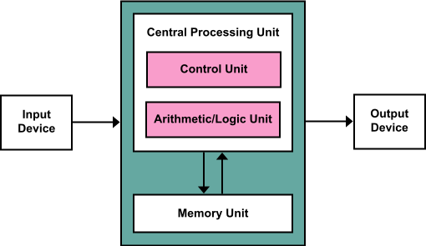
Von Neumann Architecture
CPU: ALU and control unit
Register: general-purpose and special-purpose
Bus
Main memory
Mass storage
Peripheral device: I/O
Von Neumann bottleneck

Slide 3
Havard Architecture
Separate storage and signal pathways for instructions and data.
Performance

Slide 4
Pipelining
Throughput vs. execution speed
Overlap: prefetching while executing
Instruction pipelining
Graphics pipelining
Software pipelining
HTTP pipelining

Slide 5
Multiprocessor Machine
Parallel processing
MIMD: multiple-instruction stream, multiple-data stream
SIMD: single-instruction stream, multiple-data stream

Slide 6
methods of performing input/output (I/O)
Memory-mapped I/O (MMIO)
port-mapped I/O (PMIO) or called isolated I/O
Port-mapped I/O often uses a special class of CPU instructions designed specifically for performing I/O, such as the in and out instructions
I/O devices have a separate address space from general memory, either accomplished by an extra "I/O" pin on the CPU's physical interface, or an entire bus dedicated to I/O.
for example,the x86 platform

Slide 7
via high-level language
int* ptr;
...some code...
*ptr = 0;
result in writing to a hardware input-output port if ptr happens to store the address to which that port is mapped. Usually they are called "embedded platforms".

Slide 8
device driver
A driver provides a software interface to hardware devices, enabling operating systems and other computer programs to access hardware functions without needing to know precise details of the hardware being used.

Slide 9
Reference
Computer science: an overview by J.Glenn Brookshear
Wikipedia

Slide 10
Thank you!

